Slide 2
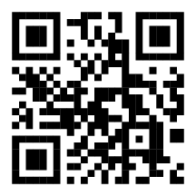
We Value and Request Your Feedback
With your help and input we can continue to deliver educational content that is the best in the industry! Feedback can be collected in 2 ways:
1. Please complete your session evaluation, handed out upon entry of this presentation, and return to the room monitor as you exit.
2. You also have the option to complete your survey form in the mobile app. To complete through the app, go to conference agenda – locate & select the appropriate session - tap on the to begin.
Your feedback is greatly appreciated and helps provide us with first-hand insight that is carefully reviewed as we plan future Medtrade Conferences!
DOWNLOAD THE MEDTRADE SHOW APP TO COMPLETE SURVEY FORM

Slide 3
Schedule of Events
EXPO HALL HOURS
Tuesday, March 3| 9:00AM – 5:00PM
Wednesday, March 4| 10:00AM – 3:00PM
Medtrade Networking Event
Monday, March 2 | 5:00PM – 6:15PM
AAHomecare Update
Tuesday, March 3 | 2:15PM – 3:15PM
DOWNLOAD THE OFFICIAL MEDTRADE 2026 SHOW APP FOR A FULL SCHEDULE

